Slide 1
Quality and safety in healthcare management
Mr. Akram Aljaffan
Msc. Quality and safety in HC management, RCSI
CPHQ

Slide 2
Agenda
What is Quality in healthcare?
Dimensions
QM building blocks
Types of healthcare use
Components of QM
MBNQ
Quality Gurus

Slide 3
Quality tools
Performance measurements
Donabedian healthcare components : Structure, process and outcomes.
JCI history
Data collection
Variation types
Control charts and SPC
Six Sigma /PDSA

Slide 4
Risk management
FMEA
Risk assessment
Incident reporting

Slide 5
Focus on Quality

Slide 6
Chapter learning outcomes
recognize factors that influence consumers’ perception of quality products and services
explain the relationship between cost and quality
recognize the quality characteristics important to healthcare consumers, purchasers and providers
demonstrate an understanding of the varied dimensions of healthcare quality

Slide 7
Quality Perceived degree of excellence
Like beauty, quality exists in the eye of the beholder
In its broadest sense, quality is an attribute of a product or service.

Slide 8
A quality product or service is one that meets or exceeds expectations. Expectations can change, so quality must be continuously improved.

Slide 9
Common features to define quality
Quality involves meeting or exceeding customer expectations.
Quality is dynamic (i.e., what is considered quality today may not be good enough to be considered quality tomorrow).
Quality can be improved

Slide 10
Quality and cost in healthcare
The cost of a product or service is indirectly related to its perceived quality.
A quality healthcare experience is one that meets a personal need or provides some benefit (either real or perceived) and is provided at a reasonable cost.

Slide 11
IOM(Institute of medicine) definition of Quality
Healthcare quality The degree to which health services for individuals and populations increase the likelihood of desired health outcomes and are consistent with current professional knowledge

Slide 12
Patients want to receive the right treatments and experience good outcomes

Slide 13
IOM Committee on Quality of Health Care in America further clarified the concept of healthcare quality. In its report, Crossing the Quality Chasm: A New Health System for the 21st Century, the committee identified six dimensions of U.S. healthcare needing improvement:

Slide 14
Quality dimensions (IOM, 2001)
Safety—Care intended to help patients should not harm them.
• Effectiveness—Care should be based on scientific knowledge and provided to patients who could benefit. Care should not be provided to patients unlikely to benefit from it. In other words, underuse and overuse should be avoided.
• Patient-centeredness—Care should be respectful of and responsive to individual patient preferences, needs, and values, and patient values should guide all clinical decisions.

Slide 15
Quality dimensions
• Timeliness—Care should be provided promptly when the patient needs it.
• Efficiency—Waste, including equipment, supplies, ideas, and energy, should be avoided.
• Equity—The best possible care should be provided to everyone, regardless of age, sex, race, financial status, or any other demographic variable.

Slide 16
Dr. Donald Berwick (2005), president of the Institute for Healthcare Improvement, put this description into consumer terms when he wrote about his upcoming knee replacement and what he expected from his providers:
Don’t kill me (no needless deaths).
Do help me and don’t hurt me (no needless pain)
Don’t make me feel helpless.
Don’t keep me waiting.
Don’t waste resources—mine or anyone else’s

Slide 17
Discussion question
Think about your most recent healthcare encounter. What aspects of the care or service were you pleased with? What could have been done better?

Slide 18
QUALITY MANAGEMENT BUILDING BLOCKS

Slide 19
describe the three primary quality management activities: measurement, assessment, ➤ and improvement;
recognize quality pioneers’ contributions to, and influence on, the manufacturing ➤ industry;
identify factors that prompted healthcare organizations to adopt quality practices ➤ originally developed for use in other industries; and
describe external forces that influence quality management activities in healthcare ➤ organizations.

Slide 20
Quality management
The goal of quality management in any industry is to achieve maximum customer satisfaction at the lowest overall cost to the organization while continuing to improve the process.

Slide 21
Berwick ( 2002) defines three types of healthcare services use:
Overuse
Misuse
Underuse

Slide 22
Overuse occurs when a service is provided even though there is no evidence it will help the patient—for example, prescribing antibiotics for patients with viral infections.
Underuse occurs when a service that would have been medically beneficial for the patient is not provided—for example, performing a necessary diagnostic test.
Misuse occurs when a service is not carried out properly—for example, operating on the wrong part of the patient’s body.

Slide 23
Components of Q Management
Quality management involves:
measurement, assessment, and improvement

Slide 24
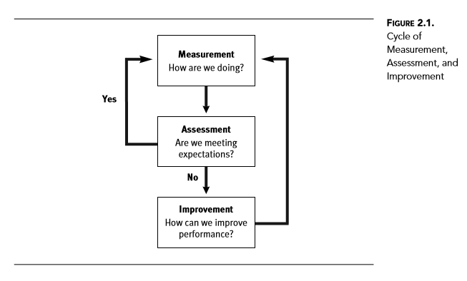

Slide 25
The contemporary quality movement in the manufacturing industry can be traced to work done by three men in the 1920s at Western Electric Company in Cicero, Illinois.
Walter Shewhart, W. Edwards Deming, and Joseph Juran learned and applied the science of quality improvement to the company’s production lines (American Society for Quality 2008)

Slide 26
Shewhart is referred to as the father of statistical quality control
W. Edwards Deming (1994) learned Shewhart’s methods and made measurement and control of process variation one of the key elements of his philosophy of quality management:
Organizations are a set of interrelated processes with a common aim. ◆ Process variation must be understood. ◆ How new knowledge is generated must be ◆ understood. How people are motivated and work together ◆ must be understood.

Slide 27
Following World War II, Japanese manufacturing companies invited Deming to help them improve the quality of their products. Over a period of several years, as a result of Deming’s advice, many low-quality Japanese products became world class.

Slide 28
Joseph Juran combined the science of quality with its practical application, providing a framework for linking finance and management. The components of the Juran Quality Trilogy are (Uselac 1993)
quality planning —define customers and how to meet their needs
quality control —keep processes working well.
quality improvement—learn, optimize, refine, and adapt.

Slide 29
In the 1950s, Juran, like Deming, helped jump-start product improvements at Japanese manufacturing companies. Whereas Deming focused on measuring and controlling process variation, Juran focused on developing the managerial aspects supporting quality.
One of Juran’s management principles—focusing improvements on the “vital few” sources of the problems

Slide 30
Kaoru Ishikawa, a Japanese engineer who incorporated the science of quality into Japanese culture.
He was one of the first people to emphasize the importance of involvement of all members of the organization instead of only management-level employees.

Slide 31
Ishikawa believed that top-down quality goals could be accomplished only through bottom-up methods (Best and Neuhauser 2008).
To support his belief, he introduced the concept of quality circles—groups of 3 to 12 frontline employees that meet regularly to analyze production-related problems and propose solutions (Ishikawa 1990).

Slide 32
Americans learned about the quality philosophies of Deming, Juran, and Ishikawa; the science of industrial quality; and the concept of quality control as a management tool.
In 1980, NBC aired a television program titled If Japan Can . . . Why Can’t We? which described how Japanese manufacturers had adopted Deming’s approach to continuous improvement, most notably his focus on variation control (Butman 1997, 163).

Slide 33
During the 1980s, Juran, Deming, Philip Crosby, Armand Feigenbaum, and others received widespread attention as philosophers of quality in the manufacturing and service industries.

Slide 34
In 1987, President Reagan signed into law the Malcolm Baldrige National Quality Improvement Act (Spath 2005, 23–25). This national quality program, managed by the U.S. Commerce Department’s National Institute of Standards and Technology, established criteria for performance excellence

Slide 35
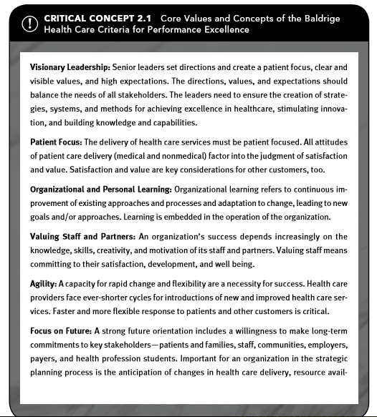

Slide 36
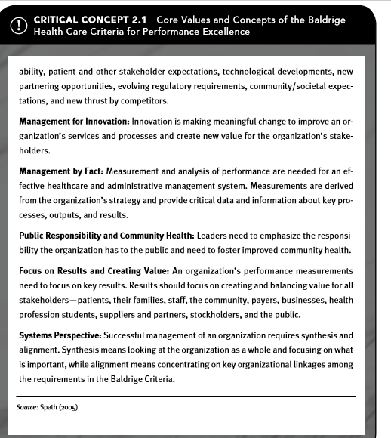

Slide 37
Before 1970 Quality management was
Train the craftspeople (physicians, nurses, technicians, etc.), license or certify them, supply them with an adequate structure (facilities, equipment, etc.), and then let them provide health services (Merry 2003).

Slide 38
In 1913, the American College of Surgeons (ACS) was founded to address variations in the quality of medical education.
A few years later, it developed the hospital standardization program to address the quality of facilities in which physicians worked

Slide 39
the ACS hospital standardization program was turned over to The Joint Commission (2007), the United States’ oldest and largest healthcare accreditation group, which evaluates and accredits more than 15,000 healthcare organizations and programs across the nation.
The standards centered on structural requirements and eliminating incompetent people, not measuring and controlling variation in healthcare processes.

Slide 40
The Joint Commission accreditation standards served as a model for provider quality requirements of the Medicare healthcare program for the elderly, passed by Congress in 1965.

Slide 41
In 1980, The Joint Commission added a quality assurance (QA) standard loosely based on the work of Deming and Juran (Affeldt 1980).

Slide 42
The QA standard required organizations to implement an organization-wide program to (The Joint Commission 1979)
identify important or potential problems or concerns with patient care, ◆ objectively assess the cause and scope of the problems or concerns, ◆ implement decisions or actions designed to eliminate the problems, ◆ monitor activities to ensure desired results are achieved and sustained, and ◆ document the effectiveness of the overall program to enhance patient care and ◆ ensure sound clinical performance.

Slide 43
From 1980 to 1992, the cost of healthcare increased from $255 billion to $717 billion, from just under 9 percent of the gross national product in 1980 to 13.1 percent in 1992 (Kaiser Family Foundation 2002, 6–7).

Slide 44
Accreditation is a voluntary process by which the performance of an organization is measured against nationally accepted standards of performance.
Accreditation standards are based on government regulations and input from individuals and groups in the healthcare industry.
Healthcare organizations seek accreditation because it:
enhances public confidence
Is an objective evaluation of the organization’s performance
stimulates the organization’s quality improvement efforts.

Slide 45
MEASURING PERFORMANCE

Slide 46
Learning outcomes
apply structural, process, and outcome measures to evaluate quality
describe common performance measures of healthcare services
demonstrate the steps involved in developing performance measures
identify national groups influencing healthcare performance measurement priorities
recognize how healthcare organizations select performance measures
describe the difference between measures of healthcare services and measures of clinical decision making; and
identify the role of balanced scorecards in performance measurement

Slide 47
3.3 MeasureMent categOries
Hundreds of measures can be used to evaluate healthcare performance. These measures are grouped into three categories:
Structure measures ◆ Process measures ◆ Outcome measures

Slide 48
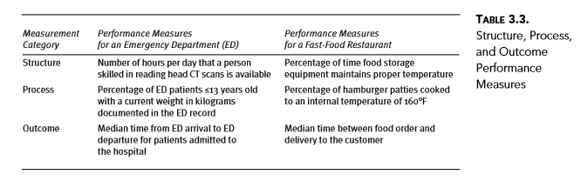

Slide 49
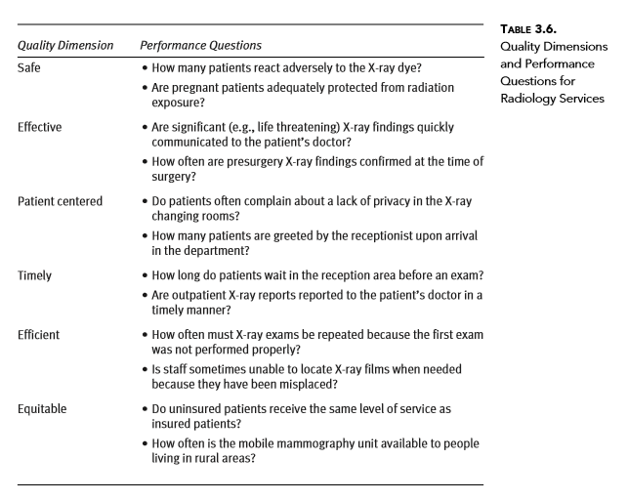

Slide 50
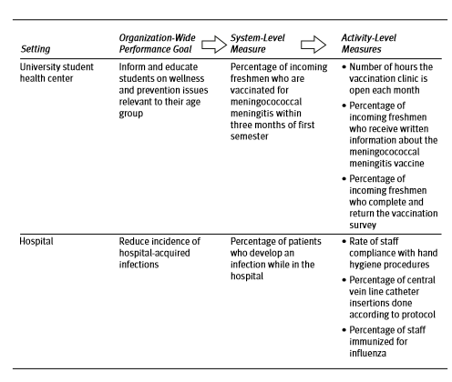

Slide 51
Suppose the radiology manager chooses to answer the question regarding timely reporting of X-ray exam results to patients’ doctors. The department policy states that results are to be telephoned or faxed to patients’ doctors within 48 hours of their exams. To turn the question into a performance measure, the manager decides to use the percentage of results communicated to doctors within 48 hours of completion of an outpatient X-ray exam.
To ensure he knows what information this measure will provide, the manager rewrites the measure in terms of the data that will be used to calculate it, as follows: Number of outpatient exam results reported to doctor within 48 hours × 100 Total number of exams performed

Slide 52
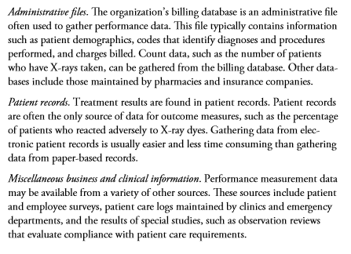
Data collection sources

Slide 53
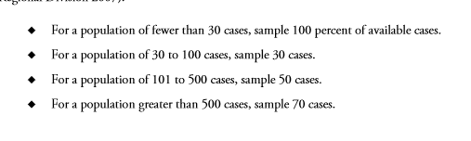

Slide 54
Data collection plan
Who
When
How
What
Where

Slide 55
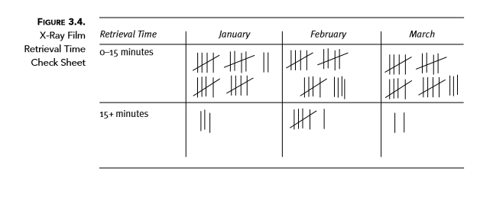
Time taken for a radiology clerk to find film in the first quarter

Slide 56
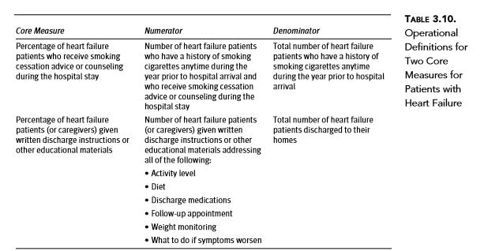

Slide 57
EVALUATING PERFORMANCE

Slide 58
Learning outcomes
identify common ways of reporting measurement data to facilitate performance ➤ assessment,
apply methods of interpreting healthcare performance measurement data, ➤
describe the role of performance targets in evaluating performance, ➤
identify common techniques for establishing performance expectations, and ➤
explain how comparative performance data are used for assessment purposes

Slide 59
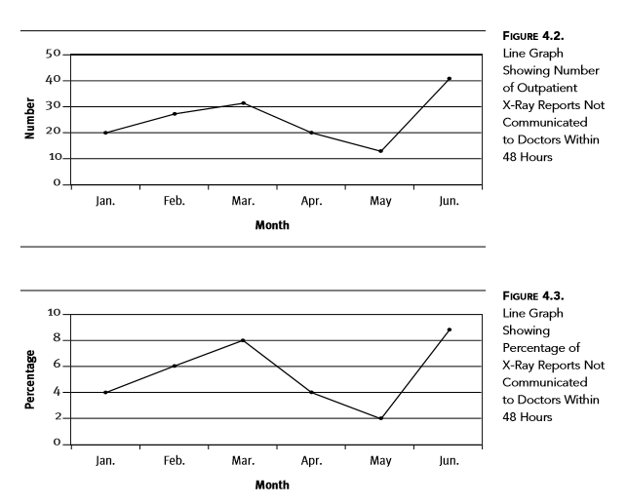
Graphing data

Slide 60
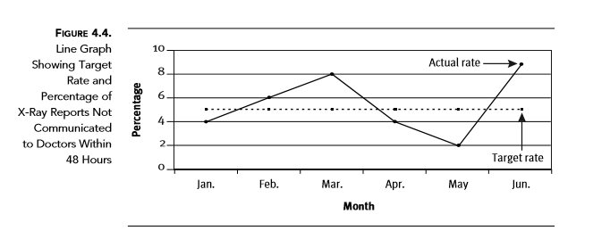

Slide 61
Assessment involves judging or evaluating measurement data for the purpose of reaching a conclusion.
The presentation of the measurement data influences its interpretation for performance assessment purposes.
To display data in an understandable form, three factors must be considered: the type of data to be reported, the audience, and the information’s intended use.

Slide 62
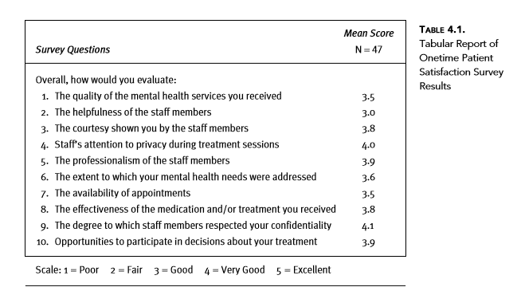
Tabular reports

Slide 63
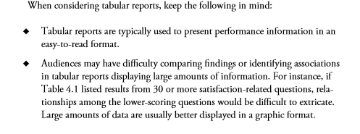

Slide 64
Data visualization

Slide 65
Pie chart
Use pie charts to illustrate distribution or composition of a single variable. ◆ The single variable in Figure 4.5 is patient complaints. Use pie charts only for variables with mutually exclusive values (i.e., no cases ◆ are included in more than one category). In the mental health clinic telephone survey, patients could pick only one complaint, which made the categories in Figure 4.5 mutually exclusive. Avoid using pie charts for variables that have more than five categories

Slide 66
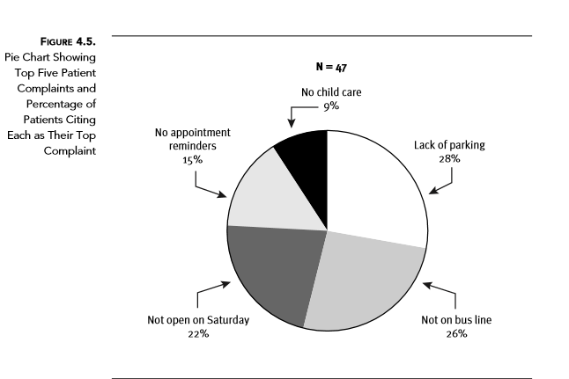

Slide 67
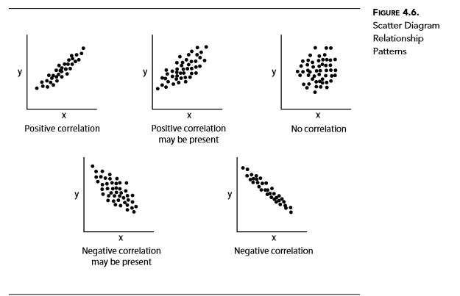
Scatter diagram

Slide 68
Scatter diagrams are tools for analyzing relationships between two variables. One variable is plotted on the horizontal axis (x-axis), and the other is plotted on the vertical axis (y-axis). The distribution of their intersecting points reveals relationship patterns, as illustrated in Figure 4.6. If one variable increases when the other increases, they are positively correlated. If one variable decreases when the other increases, they are negatively correlated

Slide 69
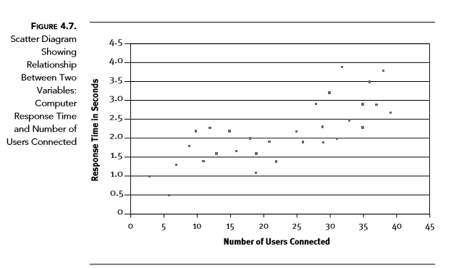

Slide 70
When considering scatter diagrams, keep the following in mind:
Use scatter diagrams to examine theories about cause-and-effect relationships. ◆ The scatter diagram in Figure 4.7 helped the IT department manager identify the causes of a performance problem. Scatter diagrams usually show one of five possible correlations between the ◆ two variables:
Strong positive correlation• : The value on the y-axis increases as the value on the x-axis increases.
Strong negative correlation• : The value on the y-axis decreases as the value on the x-axis increases.

Slide 71
Possible positive correlation• : The value on the y-axis increases slightly as the value on the x-axis increases.
Possible negative correlation• : The value on the y-axis decreases slightly as the value on the x-axis increases. No correlation• : No connection is evident between the two variables.

Slide 72
Bar graphs, sometimes called bar charts, also can be used to display measurement data from a snapshot of time. Audiences can easily compare groups of data included in the chart and quickly assess their implications on performance. One axis of the chart shows the quality attribute being measured, and the other axis represents actual performance results.

Slide 73
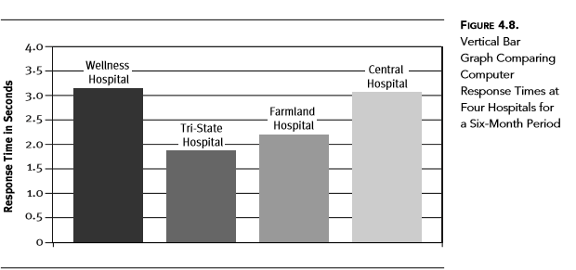

Slide 74
Histograms, sometimes referred to as frequency distributions, are another type of graph used to show snapshots of performance. Histograms are bar charts that show a distribution of values in ranks along the x-axis. Figure 4.10 is a histogram illustrating the distribution of patient wait times in a clinic. Wait time data were gathered for one week, and the data were grouped into three wait time categories. The number of patients in each category is also shown.

Slide 75
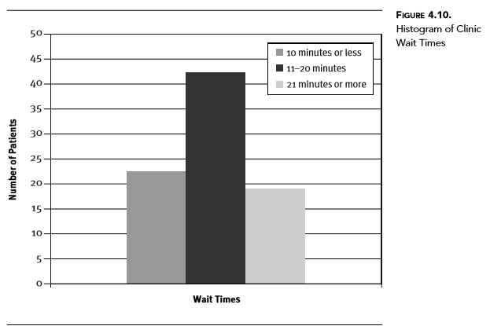

Slide 76
When considering histograms, keep the following in mind:
Use a histogram to display distributions of a variable that can be separated ◆ into ranks, such as three-month segments of a year or age ranges. As shown in Figure 4.10, bars in a histogram should touch one another ex- ◆ cept when there are intervals along the x-axis indicating no cases in a category. A histogram is a bar graph that shows the ◆ central tendency and variability of a data set. It can be used to quickly and easily illustrate the distribution of performance data

Slide 77
Pareto charts are similar to histograms, except they sort performance data in order of decreasing frequency and include other annotations (such as a cumulative percentage line) to highlight the Pareto principle

Slide 78
states that for many events, 80 percent of the effects come from 20 percent of the causes (Juran 1974). Joseph Juran, one of the originators of the science of quality, applied the Pareto principle to quality management. Juran advised management to concentrate improvement efforts on the “vital few” sources of problems and not be distracted by those of lesser importance (Scholtes 1992, 2–9)

Slide 79
Pareto charts are used to identify the 20 percent of the problems (the “vital few”) affecting 80 percent of performance. Resolving these problems should have the greatest impact on performance improvement

Slide 80
When considering Pareto charts, keep the following in mind:
Use Pareto charts to separate the few major ◆ problems (the vital few) from the many possible problems (the trivial many). Pareto charts encourage use of data, not perception, to determine which problems are most important. Arrange performance categories or problems according to their frequency ◆ (how many), not their classification (what kind). The order should descend from left to right. The right vertical axis can be used to measure the percentage of total occur- ◆ rences in each category, but in some situations, the main problems may be apparent without adding a cumulative percentage trend line.

Slide 81
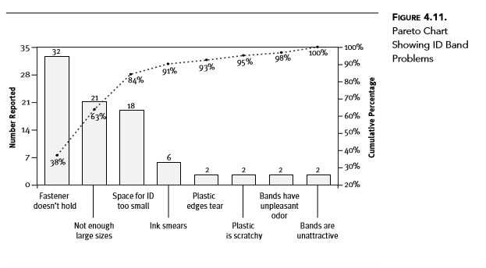

Slide 82
The manager concludes from the data in Figure 4.11 that there are three main problems.
A different brand of wristband would solve two of the problems.
The department needs one that fastens better and has more space for the patient’s identifying information.
The third problem—insufficient inventory of large bands—would be solved by keeping more large bands in stock to accommodate larger patients.
If these problems are resolved, complaints about ID bands should decrease by more than 80 percent.

Slide 83
Radar charts are used to plot five to ten performance measures for an interval of time, along with performance expectations.
Radar charts are sometimes called spider charts because of their shape. Figure 4.12 is a radar chart showing patient satisfaction survey results from a healthcare system.
The solid line represents the actual results, and the dotted line represents the expected performance or target rates

Slide 84
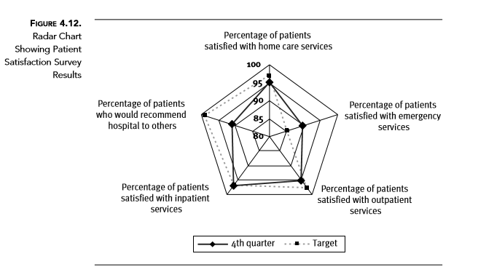

Slide 85
Benchmarking Learning about the practices in other companies for the purpose of using them in your own organization

Slide 86
In addition to comparing performance to predefined goals, healthcare organizations are increasingly using statistical process control (SPC) to assess performance.
This technique is used to highlight variations in performance that should be investigated.

Slide 87
For instance, suppose that every day you plot on a line graph the number of minutes you take to run three miles. After a 30-day period, your daily run times would vary somewhat but would likely remain in a predictable range (some variation is expected in any process).

Slide 88
At what point is your run time significantly different from the norm? To answer this question, you use data from the past 30 days to calculate the upper and lower limits of your run time norm. When you plot the current day’s time on the graph, you can see whether the time lies in the normal range.

Slide 89
The upper and lower limits of your run time norm are based on the statistical theory of a normal distribution. About 68 percent of values drawn from a normal distribution are within one standard deviation of the mean, about 95 percent of the values are within two standard deviations, and about 99 percent lie within three standard deviations (Research Methods Knowledge Base 2006).
If the upper and lower limits of your normal run time are set at three standard deviations from the mean, you have little chance of registering a run time outside of these parameters.

Slide 90
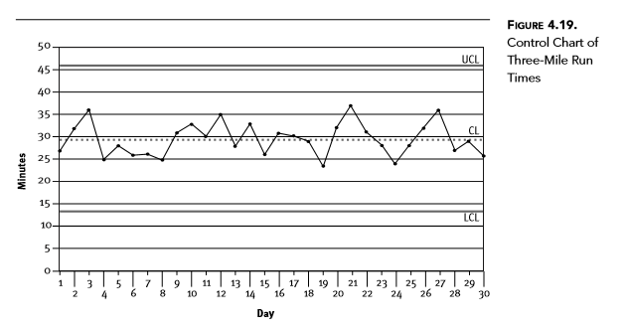

Slide 91
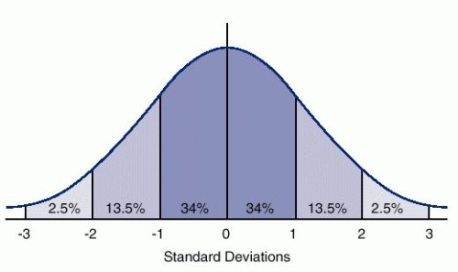
Bell’s curve

Slide 92
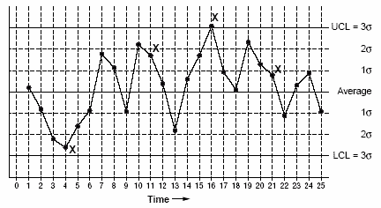

Slide 93
Line graph SPC techniques can be applied to data displayed in a line graph without calculating upper and lower limits of the normal range. Only the average or mean of the data is calculated and displayed as a center line on the graph. Ideally, the line graph should have a minimum of 15 data points; some statisticians suggest a minimum of 20 data points (Woodall 2000).
Performance results plotted on the graph are compared to the center line to locate significant performance shifts or trends. A shift or trend represents potentially unstable performance that needs to be investigated.

Slide 94
A significant shift in performance is evident when one of the following situations occurs:
Seven consecutive data points appear above or below the center line on a line ◆ graph with less than 20 data points (ignore data points that fall on the center line). Eight consecutive data points appear above or below the center line on a line ◆ graph with 20 or more data points (ignore data points that fall on the center line).
A significant performance trend is evident when one of the following situations occurs:
Seven consecutive data points move steadily upward or downward on a line ◆ graph with less than 20 data points (points may fall on or cross the center line). Eight consecutive data points move steadily upward or downward on a line ◆ graph with 20 or more data points (points may fall on or cross the center line).

Slide 95
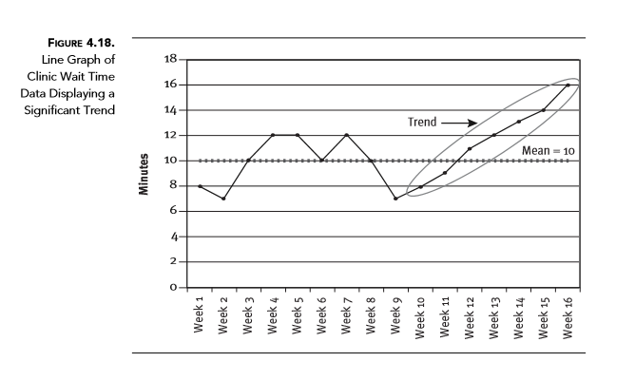

Slide 96
The line graph of clinic wait time data shown in Figure 4.18 illustrates how this SPC technique is applied during performance assessment. Starting at week 10, the wait time slightly increases. By week 16, the wait time has increased seven consecutive times— a signal that the upward trend is likely to continue. Like unusual shifts in performance, trends should be investigated.

Slide 97
Identifying Variation
When a process is stable and in control, it displays common cause variation, variation that is inherent to the process. A process is in control when based on past experience it can be predicted how the process will vary (within limits) in the future. If the process is unstable, the process displays special cause variation, non-random variation from external factors.
Control charts are simple, robust tools for understanding process variability.

Slide 98
Sources of Variation in Production and Service Processes
Common causes of variation
Random causes that we cannot identify
Unavoidable
Cause slight differences in process variables like diameter, weight, service time, temperature, etc.
Assignable causes of variation
Causes can be identified and eliminated
Typical causes are poor employee training, worn tool, machine needing repair, etc.

Slide 99
History of Control Charts
Developed in 1920’s
By Dr. Walter A. Shewhart
Shewhart worked for Bell Telephone Labs
Notes:
http://deming.eng.clemson.edu/pub/tutorials/qctools/ccmain1.htm#History
“Dr. Shewhart developed the control charts as an statistical approach to the study of manufacturing process variation for the purpose of improving the economic effectiveness of the process. These methods are based on continuous monitoring of process
variation.”

Slide 100
Two Types of Control Charts
Variable Control Charts
Attribute Control Charts
Notes:
These are the main to types of control charts. Each type has several specific charts that deal with a specific sample set of data.

Slide 101
Variable Control Charts
Deal with items that can be measured .
Examples
1) Weight
2) Height
3) Speed
4) Volume
Notes:
Use variable charts should be used whenever the data is something that is measured. The data should be for example the weight of a piece of candy.

Slide 102
Types of Variable Control Charts
X-Bar chart
R chart
MA chart
Notes:
The main types of variable control charts are listed above.

Slide 103
Variable Control Charts
X chart: deals with a average value in a process
R chart: takes into count the range of the values
MA chart: take into count the moving average of a process
Notes:
These are the definitions of the specific types of variable control charts. This will help in determining what type of chart to use when you are collecting sample data.

Slide 104
Attribute Control Charts
Control charts that factor in the quality attributes of a process to determine if the process is performing in or out of control.
Notes:
Definition of attribute control charts. Tests the quality of the specific attributes of a product.

Slide 105
Types of Attribute Control Charts
P chart
C Chart
U Chart
Notes:
The main types of attribute control charts are listed above.

Slide 106
Constructing a X-bar Chart:
A quality control inspector at the Cocoa Fizz soft drink company has taken three samples with four observations each of the volume of bottles filled. If the standard deviation of the bottling operation is .2 ounces, use the data below to develop control charts with limits of 3 standard deviations for the 16 oz. bottling operation.
 | Time 1 | Time 2 | Time 3
Observation 1 | 15.8 | 16.1 | 16.0
Observation 2 | 16.0 | 16.0 | 15.9
Observation 3 | 15.8 | 15.8 | 15.9
Observation 4 | 15.9 | 15.9 | 15.8

Slide 107
Step 1: Calculate the Mean of Each Sample
 | Time 1 | Time 2 | Time 3
Observation 1 | 15.8 | 16.1 | 16.0
Observation 2 | 16.0 | 16.0 | 15.9
Observation 3 | 15.8 | 15.8 | 15.9
Observation 4 | 15.9 | 15.9 | 15.8
Sample means (X-bar) | 15.875 | 15.975 | 15.9

Slide 108
Step 2: Calculate the Standard Deviation of the Sample Mean

Slide 109
Step 3: Calculate CL, UCL, LCL
Center line (x-double bar):
Control limits for ±3σ limits (z = 3):

Slide 110
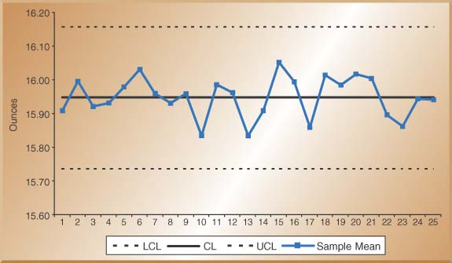
Step 4: Draw the Chart

Slide 111
An Alternative Method for the X-bar Chart Using R-bar and the A2 Factor
Sample Size
(n)
Factor for x-Chart
Factors for R-Chart
Use this method when sigma for the process distribution is not known. Use factor A2 from Table 6.1
A2
D3
D4
2
1.88
0.00
3.27
3
1.02
0.00
2.57
4
0.73
0.00
2.28
5
0.58
0.00
2.11
6
0.48
0.00
2.00
7
0.42
0.08
1.92
8
0.37
0.14
1.86
9
0.34
0.18
1.82
10
0.31
0.22
1.78
11
0.29
0.26
1.74
12
0.27
0.28
1.72
13
0.25
0.31
1.69
14
0.24
0.33
1.67
15
0.22
0.35
1.65

Slide 112
Step 1: Calculate the Range of Each Sample and Average Range
 | Time 1 | Time 2 | Time 3
Observation 1 | 15.8 | 16.1 | 16.0
Observation 2 | 16.0 | 16.0 | 15.9
Observation 3 | 15.8 | 15.8 | 15.9
Observation 4 | 15.9 | 15.9 | 15.8
Sample ranges (R) | 0.2 | 0.3 | 0.2

Slide 113
Step 2: Calculate CL, UCL, LCL
Center line:
Control limits for ±3σ limits:

Slide 114
Control Chart for Range (R-Chart)
Center Line and Control Limit calculations:
Factor for x-Chart
Factors for R-Chart
Sample Size
(n)
A2
D3
D4
2
1.88
0.00
3.27
3
1.02
0.00
2.57
4
0.73
0.00
2.28
5
0.58
0.00
2.11
6
0.48
0.00
2.00
7
0.42
0.08
1.92
8
0.37
0.14
1.86
9
0.34
0.18
1.82
10
0.31
0.22
1.78
11
0.29
0.26
1.74
12
0.27
0.28
1.72
13
0.25
0.31
1.69
14
0.24
0.33
1.67
15
0.22
0.35
1.65

Slide 115
R-Bar Control Chart

Slide 116
Control Charts for Attributes –P-Charts & C-Charts
Use P-Charts for quality characteristics that are discrete and involve yes/no or good/bad decisions
Percent of leaking caulking tubes in a box of 48
Percent of broken eggs in a carton
Use C-Charts for discrete defects when there can be more than one defect per unit
Number of flaws or stains in a carpet sample cut from a production run
Number of complaints per customer at a hotel

Slide 117
Constructing a P-Chart:
A Production manager for a tire company has inspected the number of defective tires in five random samples with 20 tires in each sample. The table below shows the number of defective tires in each sample of 20 tires.
Sample | Sample Size (n) | Number Defective
1 | 20 | 3
2 | 20 | 2
3 | 20 | 1
4 | 20 | 2
5 | 20 | 1

Slide 118
Step 1: Calculate the Percent defective of Each Sample and the Overall Percent Defective (P-Bar)
Sample | Number Defective | Sample Size | Percent Defective
1 | 3 | 20 | .15
2 | 2 | 20 | .10
3 | 1 | 20 | .05
4 | 2 | 20 | .10
5 | 1 | 20 | .05
Total | 9 | 100 | .09

Slide 119
Step 2: Calculate the Standard Deviation of P.

Slide 120
Step 3: Calculate CL, UCL, LCL
Center line (p bar):
Control limits for ±3σ limits:

Slide 121
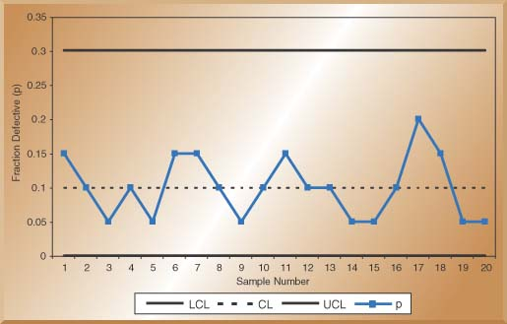
Step 4: Draw the Chart

Slide 122
Constructing a C-Chart:
Week | Number of Complaints
1 | 3
2 | 2
3 | 3
4 | 1
5 | 3
6 | 3
7 | 2
8 | 1
9 | 3
10 | 1
Total | 22
The number of weekly customer complaints are monitored in a large hotel. Develop a three sigma control limits For a C-Chart using the data table On the right.

Slide 123
Calculate CL, UCL, LCL
Center line (c bar):
Control limits for ±3σ limits:

Slide 124
Attribute Control Charts
P Chart: a chart of the percent defective in each sample set.
C chart: a chart of the number of defects per unit in each sample set.
U chart: a chart of the average number of defects in each sample set.
Notes:
The definitions of the attribute control charts, help in determining the correct chart to use given a sample set of data.

Slide 125
Reasons for using Control Charts
Improve productivity
Make defects visible
Determine what process adjustments need to be made
Determine if process is “in” or “out of control
Notes:
Control charts can be a huge asset to a company if used correctly. The reason for using control charts are clear, they will help your company improve.

Slide 126
p Chart
The p-chart is used with "binomial" data.
P-charts are used for results of two possible outcome data.
For example, a p-chart may be used to chart the percentage or fraction of each sample that is nonconforming to the safety requirements.

Slide 127
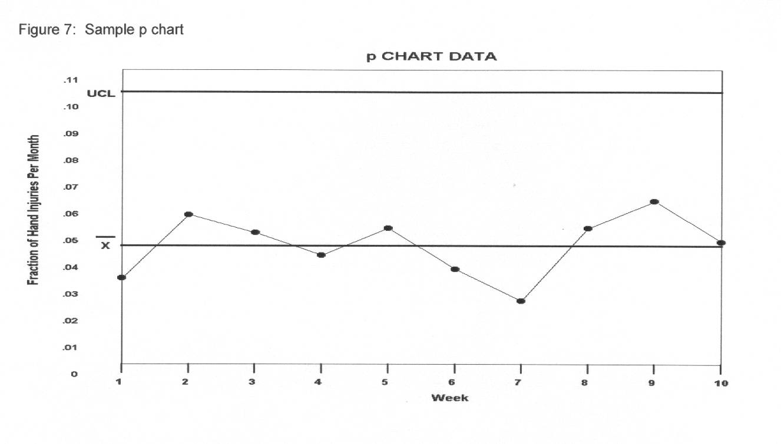
Sample p-chart

Slide 128
c Chart
The c-chart is also used for "Poisson" processes.
Occurrence reporting data (i.e.: number of accidents per month) empirically appear to fit the "Poisson" model.
The number of nonconformities per "unit" and is denoted by c with the "unit" being commonly referred to as an inspection unit such as "per month."

Slide 129
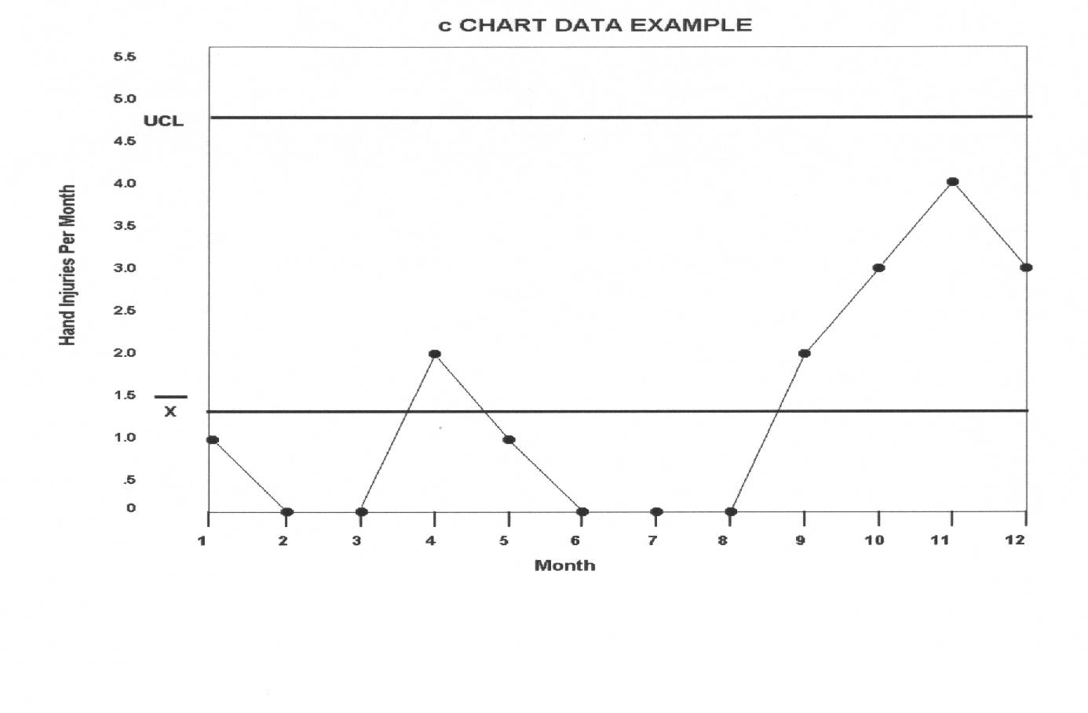
Figure 8: Sample c Chart

Slide 130
CONTINUOUS IMPROVEMENT

Slide 131
explain the purpose of a systematic approach to improving performance, ➤
discuss common performance improvement models, ➤
recognize the similarities and differences among improvement models, and ➤
demonstrate an understanding of the steps in a performance improvement project

Slide 132
Opportunities for better performance trigger improvement projects. A typical project incorporates four steps: 1. Define the improvement goal. 2. Analyze current practices. 3. Design and implement improvements. 4. Measure success.

Slide 133
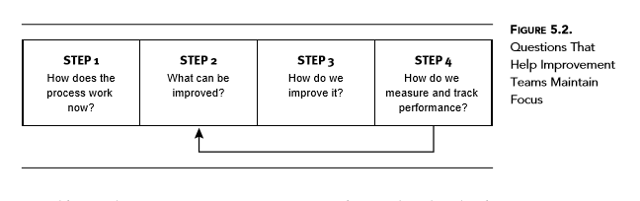

Slide 134
PDCA
Walter Shewhart, who developed the concepts and techniques of statistical process control, was one of the first quality experts to discuss a systematic model for continuous improvement. In his book Statistical Method from the Viewpoint of Quality Control, published in 1939, he referred to this model as the Plan-Do-Check-Act (PDCA) cycle (Best and Neuhauser 2006).

Slide 135
Deming modified Shewhart’s original model and renamed it the Plan-Do-Study-Act (PDSA) cycle. PDSA is the most widely recognized improvement process today (see Figure 5.3)

Slide 136
Plan
State the objectives of the improvement project. ◆ Determine needed improvements. ◆ Design process changes to achieve the improvement objectives. ◆ Develop a plan to carry out the changes (define who, what, when, and where). ◆ Identify data that need to be collected to determine whether changes pro- ◆ duced desired results.

Slide 137
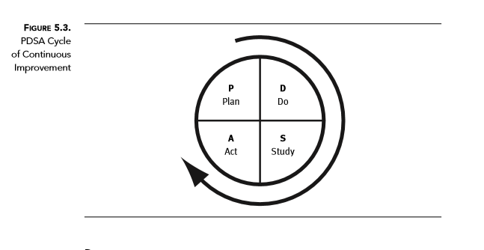

Slide 138
Do
Implement the changes on a small scale. ◆ Document problems and unexpected events. ◆ Gather data to assess the changes’ effect on the process. ◆
Study Analyze data to determine whether the changes were effective. ◆ Compare results with expectations. ◆ Summarize lessons learned during and after implementation of the changes. ◆
Act
If changes were not successful, repeat the PDSA cycle. ◆ If changes were successful, or partially successful, modify them as necessary ◆ and implement them on a wider scale. Predict results.

Slide 139
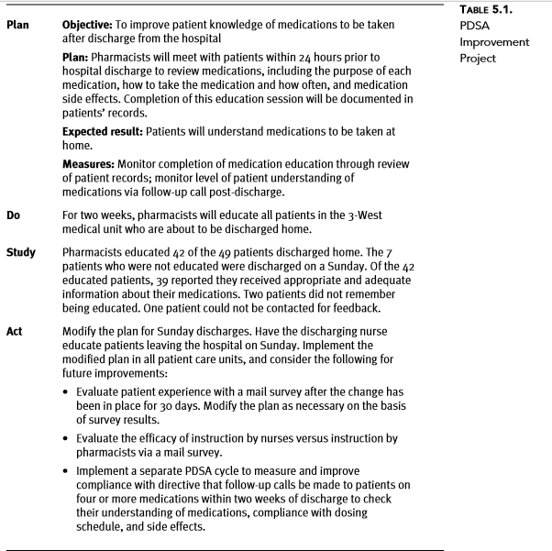

Slide 140
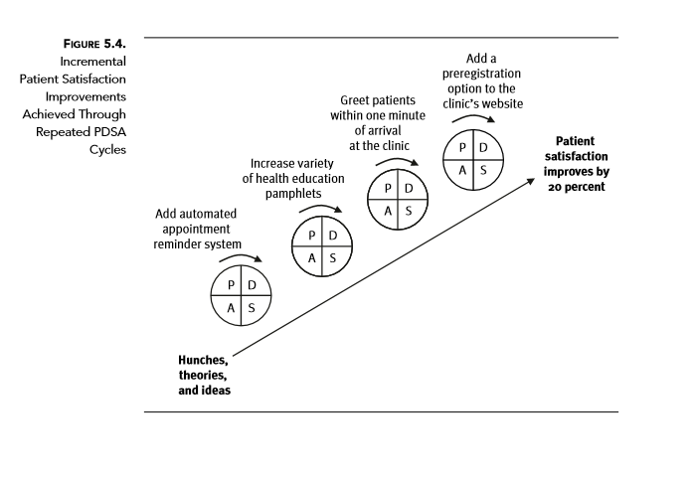

Slide 141
FOcus-pdca In the early 1990s, Hospital Corporation of America (Nashville, Tennessee) expanded Shewhart’s PDCA model by adding preliminary steps known as FOCUS (Batalden and Nolan 1992). The FOCUS-PDCA model of performance improvement involves the following steps (Batalden and Stoltz 1993):

Slide 142
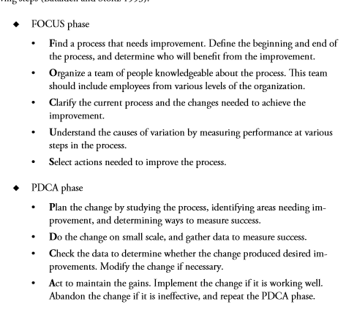

Slide 143
The FADE improvement model consists of four phases (The Joint Commission 1991, 59):
F ◆ ocus. Choose a problem, and write a statement to describe it. A ◆ nalyze. Learn more about the problem by gathering performance data. D ◆ evelop. Develop a solution for the problem and a plan for implementing the solution. E ◆ xecute. Implement the plan and monitor results. Adjust the plan as needed.

Slide 144
Lean A performance improvement approach aimed at eliminating waste; also called Lean manufacturing or Lean thinking

Slide 145
Healthcare organizations eliminate waste and thus improve efficiency and quality by applying the five Lean principles of process improvement:
Value: Identify what is important to the customer and focus on it. ◆ Value stream: Ensure all activities are necessary and add value. ◆ Flow: Strive for continuous processing through the value stream. ◆ Pull: Drive production with demand. ◆ Perfection: Prevent defects and rework

Slide 146
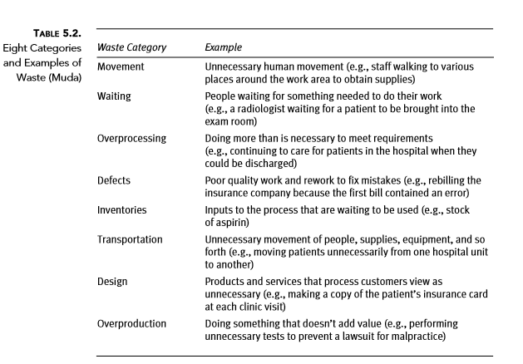

Slide 147
Six Sigma A disciplined, datadriven performance improvement approach aimed at reducing process variation for the purpose of eliminating defects (An example of a Six Sigma project is found in Table 5.3.

Slide 148
Six Sigma is a systematic, data-driven improvement approach aimed at near-elimination of defects from every product, process, and transaction. Six Sigma originated in the manufacturing sector at Motorola and was refined by General Electric, which has a healthcare consulting division.

Slide 149
Six Sigma is founded on Shewhart’s statistical process control philosophies and a field of statistics known as process capability studies (Winton 1999). Sigma (σ) is a letter in the Greek alphabet used to denote variability. For example, let’s apply Six Sigma to a hospital’s process for creating billing statements. If the process is running at three sigma, almost 7 of every 100 statements are flawed in some way

Slide 150
Reducing performance variability is the essence of Six Sigma. The goal of a Six Sigma project is to create processes that operate within Six Sigma quality, meaning the defect rate is less than 3.4 per million opportunities. This rate translates into a process that is 99.9997 percent defect-free. Most healthcare processes operate at three sigma or less (Elgert 2005).

Slide 151
Although Six Sigma projects can include a variety of structured steps, they most commonly follow the five steps of DMAIC (pronounced dee-MAY-ick) methodology (Mukherjee 2008):
D ◆ efine the problem. M ◆ easure key aspects of the process. A ◆ nalyze the data. I ◆ mprove the system. C ◆ ontrol and sustain the
improvement.

Slide 152
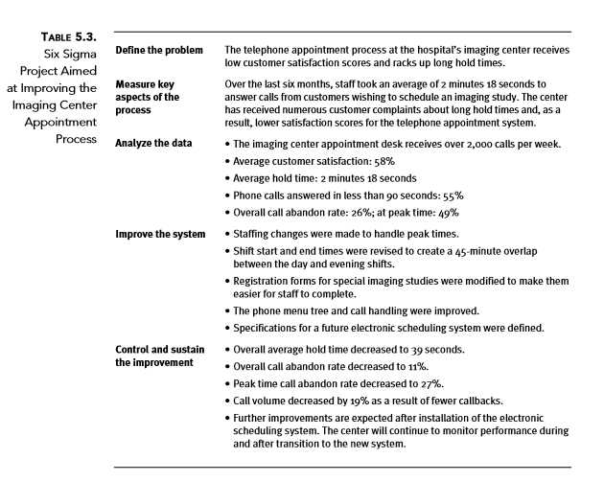

Slide 153
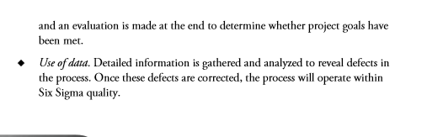

Slide 154
PERFORMANCE IMPROVEMENT TOOLS

Slide 155
describe how quality improvement tools are used throughout an improvement project, ➤
identify commonly used quantitative and qualitative improvement tools, ➤
apply improvement tools in an improvement project, and ➤
explain the difference between improvement models and improvement tools

Slide 156
Qualitative tools
Quantitative tools

Slide 157
Qualitative tools

Slide 158
Brainstorming An interactive decisionmaking technique designed to generate a large number of creative ideas

Slide 159
The most common brainstorming techniques are structured, unstructured, and silent brainstorming. In structured brainstorming, a group leader solicits ideas from group members one at a time. Participants may skip their turn if they don’t have an idea. Structured brainstorming is advantageous in that each person has an equal chance to participate, but it is disadvantageous in that it discourages spontaneity and is somewhat restrictive.

Slide 160
Multi-voting A group decision
making technique used to reduce a long list of items to a manageable one by means of a structured series of votes

Slide 161
Multi-voting often follows a brainstorming session. It is used to pare down a broad list of ideas and establish priorities

Slide 162
Suppose an improvement team charged with reducing patient wait times in an outpatient clinic has identified several problems that contribute to service delays.
They know they can’t fix all of these problems at once, so they use multi-voting to determine which problems they should address first. The problems are listed on a flipchart in random order. Team members are given ten self-stick dots (color is irrelevant) and told to place them next to the problems they feel are most urgent.

Slide 163
They are instructed to use all ten dots but to place no more than four dots on one problem. When everyone is done, the number of dots next to each problem is tallied.
The problems with the highest number of dots are addressed first. A few clear winners usually stand out. Before finalizing the list of high-priority problems, the team may discuss the results to ensure everyone agrees with the selection.

Slide 164
Nominal group technique A structured form of brainstorming used to identify and rank issues

Slide 165
Nominal group technique, a more structured form of multi-voting, involves five steps

Slide 166
In the first step, the discussion leader states the problem and clarifies it if necessary to ensure everyone understands. In the second step, each team member silently records potential solutions to the problem and does not discuss them with other team members (as in silent brainstorming). In the third step, each person shares one idea with the group, and the discussion leader records the idea on a flip chart. The process is repeated until all solution ideas have been recorded. As in step two, the ideas are not discussed. In the fourth step, the team clarifies the ideas listed on the flip chart. The discussion leader may ask some team members to explain their ideas.

Slide 167
Comments from other members are not allowed during the explanation. The goal in this step is to ensure everyone understands the suggested solutions. In the final step, the team votes on the ideas silently. Team members are asked to select five ideas they think are most effective, record them on separate index cards, and rank them in order of importance. They mark a “5” on the card for most important, “4” for second most important, and so on. When team members have finished ranking their ideas, the discussion leader collects the cards and tallies the votes. Items that received one or no votes are removed from the list. Items with the highest total point values are most important to the group and should be addressed first.

Slide 168
Affinity diagrams Charts used by improvement teams to organize ideas and issues, gain a better understanding of a problem, and brainstorm potential solutions

Slide 169
Affinity diagrams are used to organize large amounts of language data (ideas, issues, opinions) generated by brainstorming into groupings based on the relationships between data items. This process helps improvement teams sift through large volumes of information and encourages new patterns of thinking. Affinity diagrams also help improvement teams identify difficult, confusing, unknown, or disorganized performance concerns.

Slide 170
To create an affinity diagram, team members write their ideas, issues, or opinions on separate pieces of paper or index cards and scatter them on a large table. Together, and without speaking, the team then sorts related ideas into no more than eight groups. Sorting the ideas into an affinity diagram should be a creative process, so the groups should not be named until later. This categorization process takes from 10 to 20 minutes, depending on the number of ideas.

Slide 171
Once the ideas are sorted, the team names the groups by creating header cards and placing one at the top of each. The name should describe the thread or topic that ties the cards in the group together

Slide 172
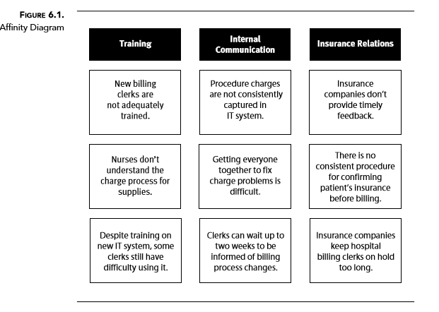

Slide 173
Cause and effect diagrams Graphic representations of the relationships between outcomes and the factors that influence them; sometimes called Ishikawa or fishbone diagrams (Examples of cause and effect diagrams are shown in figures 6.2 and 6.3.)

Slide 174
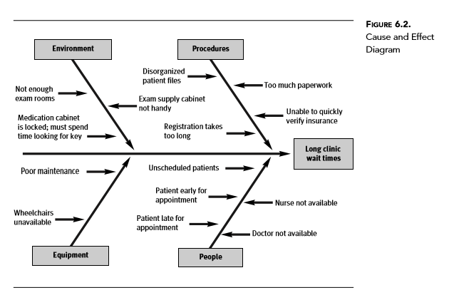

Slide 175
The four Ms—methods, manpower, materials, and machinery

Slide 176
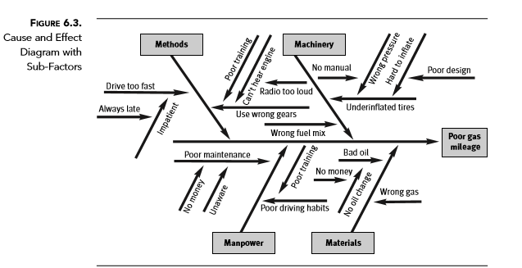

Slide 177
Decision matrix A chart used to systematically identify, analyze, and rate the strength of relationships between sets of information, especially useful for looking at large numbers of decision factors and assessing each factor’s relative importance (Table 6.2 is an example of a decision matrix.)

Slide 178
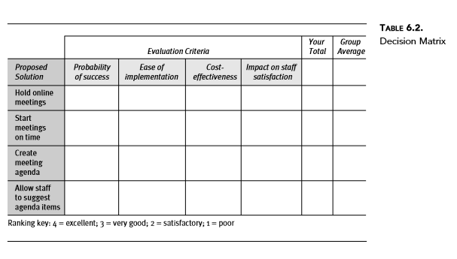

Slide 179
The Five Whys tool helps an improvement team dig deeper into the causes of problems by successively asking what and why until all aspects of the situation are reviewed and the underlying contributing factors are considered. Usually by the time the team has asked and answered five why questions, it will have reached the core problem. Teams often uncover multiple, underlying root causes during this exercise.

Slide 180
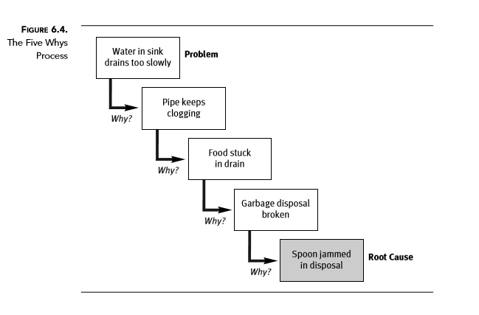

Slide 181
Flowcharts Graphic representations of a process (Examples of flowcharts are shown in figures 6.5 through 6.8.)

Slide 182
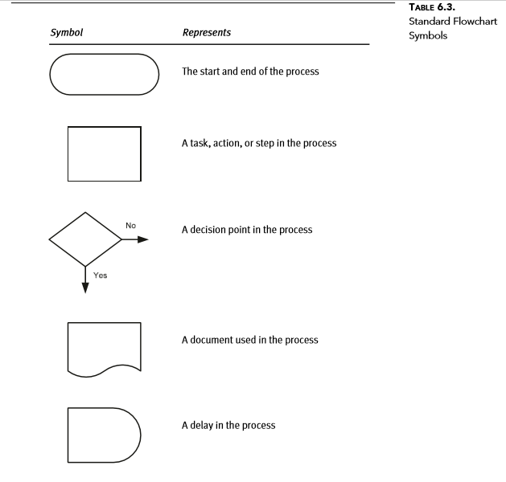

Slide 183
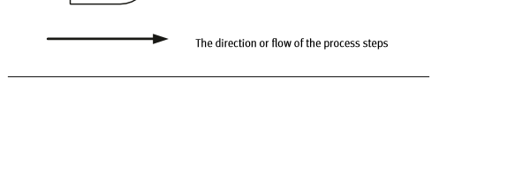

Slide 184
Can any steps be eliminated? ◆ Can any steps be combined with others? ◆ Can any steps be simplified? ◆ Can delays in the process be eliminated? ◆ Can rework loops be eliminated? ◆ Can buildup of paperwork be minimized? ◆ Can handoffs between people or departments be streamlined

Slide 185
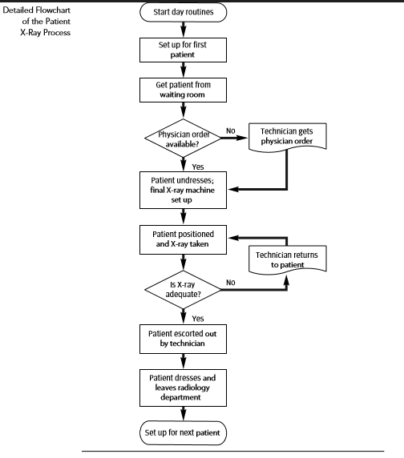

Slide 186
Surveys
Interviews

Slide 187
Force field analysis A technique for identifying and visualizing the relationships between significant forces that influence a problem or goal

Slide 188
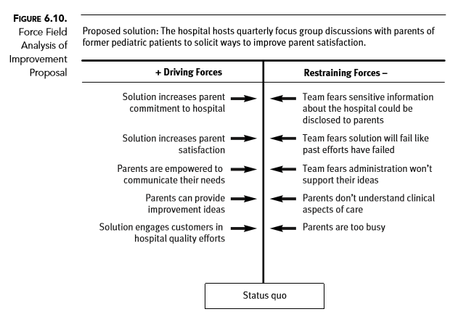

Slide 189
Stakeholder analysis A tool used to identify groups and individuals who will be affected by a process change and whose participation and support are crucial to realizing successful outcomes

Slide 190
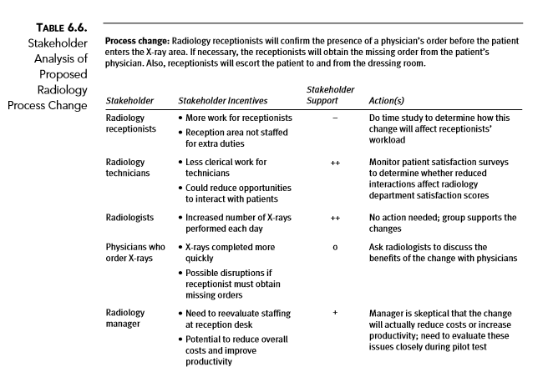

Slide 191
Planning matrix A diagram that shows tasks that need to be performed to complete an activity, the persons or groups responsible for completing the tasks, and an activity schedule with deadlines for task completion

Slide 192
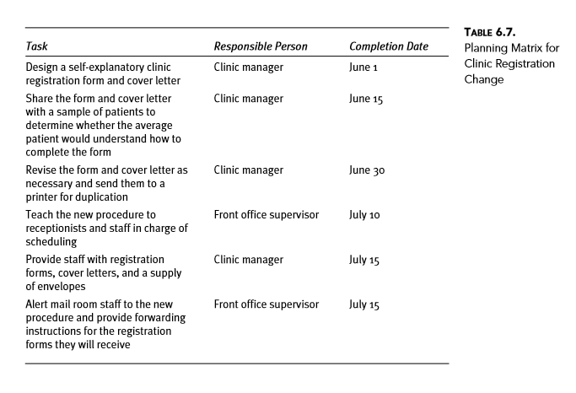

Slide 193
Quality storyboard A tool that visually communicates the major elements of an improvement project (A mock-up of a quality storyboard is shown in Figure 6.11.)

Slide 194
Quality storyboards typically include the following information:
Team information (names and roles) ◆ Project focus ◆ The opportunity for improvement• Desired results• Method that will be used to measure progress• Analysis of current situation ◆ Current process steps (flowchart or workflow diagram)• Problems identified (chart or graph)•
Quality improvement tools used to determine problem causes (diagram • or chart/graph) Proposed solutions ◆ Actions required to resolve root problem causes (chart/graph)• Description of stakeholders• Solutions executed (timeline) ◆ Effectiveness of solutions ◆ Qualitative and quantitative results (charts/graphs)• Plan for ongoing monitoring• Next steps• Lessons learned•

Slide 195
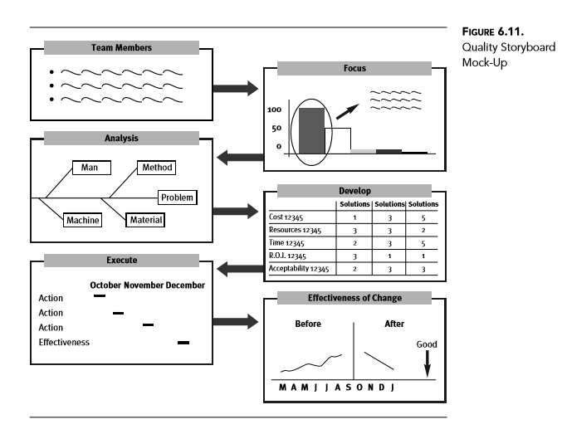

Slide 196
IMPROVING PATIENT SAFETY

Slide 197
contrast quality management and patient safety, ➤
recognize measures of patient safety, ➤
use prospective risk analysis to improve the safety of healthcare processes, ➤
use root cause analysis to improve patient safety, and ➤
describe patients’ role in reducing adverse events.

Slide 198
Medical errors Preventable adverse events or near misses related to medicine

Slide 199
Patient safety Actions undertaken by individuals and organizations to protect healthcare recipients from being harmed by the effects of healthcare services; also defined as freedom from accidental or preventable injuries produced by medical care

Slide 200
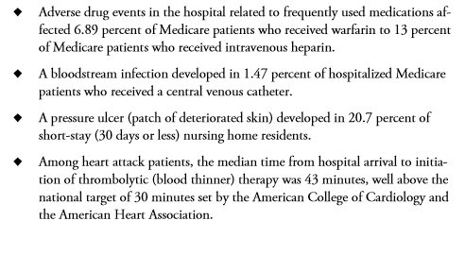

Slide 201
Safety The quality or condition of being safe; freedom from danger, injury, or damage

Slide 202
Hazards Events, actions, or things that can cause harm

Slide 203
Systems approach A methodical procedure used to identify factors that cause errors and then reduce or minimize them

Slide 204
Error An unintended act (either of omission or commission) that produces an undesirable result or significant potential for an undesirable result

Slide 205
Incidents Events or occurrences that could have led or did lead to undesirable results

Slide 206
Root cause The most fundamental reason for the occurrence of an actual or a potential event

Slide 207
Organizational culture Prevalent patterns of shared beliefs and values that provide behavioral guidelines or establish norms for conducting business

Slide 208
Accident An unplanned, unexpected event, usually with an adverse consequence

Slide 209
Risk The possibility of loss or injury

Slide 210
At best, the process can be changed to make errors impossible. We encounter examples of mistake-proofing every day. Here are just a few:
Heating devices that shut off automatically so they are not left on all day ◆ Circuit breakers that trip when circuits are overloaded ◆ Computer disks that have overwrite protection ◆ Lawn mower motors that shut off when the operator lets go of the handle

Slide 211
Safeguards Physical, human, or administrative controls incorporated into a process to identify and correct errors before a patient is harmed

Slide 212


Slide 213
Incident reports, sometimes called occurrence reports, are paper or electronic forms used to document potential or actual patient safety concerns. Employees are asked to complete a report whenever a patient is involved in an event that has caused or has the potential to cause injury. The following are examples of reportable events:
Error that occurs during the delivery of patient care (e.g., medication admin- ◆ istration mistake, treatment error) Development of a condition seemingly unrelated to a patient’s disease (e.g., ◆ infection, pressure ulcer) Adverse or suspected adverse reactions to a treatment, medication, or blood ◆ transfusion Serious injury or unexpected death of a patient ◆ Patient fall

Slide 214


Slide 215


Slide 216
FMEA is a prospective risk assessment technique used to reduce high-risk process failures. The probability and likelihood of detecting a failure is combined with an estimate of the impact of the failure to produce a criticality score. This score helps teams prioritize failures for elimination.

Slide 217
Root cause analysis (RCA) A structured process for identifying the underlying factors that caused an adverse event
Sentinel event An adverse event involving death or serious physical or psychological injury (or the risk thereof) that signals the need for immediate investigation and response

Slide 218


Slide 219


Slide 220
In 2003, the National Quality Forum called for more research regarding the ways providers can facilitate the role of patients in reducing their chance of experiencing a medical error. Since then, a growing body of research suggests patients and their family members can be additional safeguards in the healthcare system (Spath 2008b). Here are just some of the ways patients can make their hospital experience safer:
Observe/ask caregivers to perform patient identity checks before administra- ◆ tion of treatments Keep a list of prior medical history, current treatments, and allergies, and ◆ share this list with caregivers at admission

Slide 221
Know how often staff should change wound dressings, and when/how/whom ◆ to ask for a dressing change Know the type, dosage, and frequency of administration for medications; ask ◆ caregivers to explain prescribed medications to verify that they are correct; if incorrect, question the caregiver’s decision to administer the medication Observe/ask whether caregivers have washed their hands ◆ Monitor the cleanliness of the equipment and the environment and report ◆ problems Be informed about the usefulness of changing position in the hospital bed, ◆ and ask for position changes if they aren’t made as required Request help when getting out of bed, or ask for an assistive device (e.g., cane ◆ or walker) Confirm that caregivers know what the doctor has ordered ◆ Ask about equipment to understand what different sounds or noises mean; ◆ alert caregivers if there appears to be a problem

Slide 222
ORGANIZING FOR QUALITY

Slide 223
After reading this chapter, the reader will be able to
identify groups responsible for quality in a healthcare organization, ➤
describe typical participants in healthcare quality management activities, ➤
explain the purpose and content of a quality management plan, ➤
recognize aspects of organizational culture that influence the effectiveness of quality ➤ management, and
discuss strategies for overcoming environmental characteristics inhospitable to ➤ quality improvement.

Slide 224
Governing body The individuals, group, or agency with ultimate legal authority and responsibility for the overall operation of the organization; often called the board of trustees, board of governors, or board of directors

Slide 225
An organization’s governing body—the board of trustees—is ultimately responsible for the quality of healthcare services (U.S. Department of Health and Human Services 2007). The board exercises this duty through oversight of quality management activities.

Slide 226
Avedis Donabedian, physician and professor of public health at the University of Michigan from 1966 to 1989, became internationally known for his research on healthcare improvement. Prior to his death on November 9, 2000, he identified “the determination to make it work” as the most important prerequisite to ensuring quality of care: “If we are truly committed to quality, almost any mechanism will work. If we are not, the most elegantly constructed of mechanisms will fail” (Donabedian 1988).

Slide 227
Quality management system A set of interrelated or interacting elements that organizations use to direct and control the implementation of quality policies and achieve quality objectives

Slide 228


Slide 229


Slide 230
Administration’s involvement in quality management activities includes, but is not limited to, the following responsibilities:
Defining the organization’s quality management infrastructure
Assigning quality management responsibilities and holding people accountable for fulfilling them.
Allocating the resources necessary to support quality management activities
Encouraging those who use or provide the organization’s services to participate in quality management activities
Promoting physician and employee education about the concepts and techniques of quality management

Slide 231
Using performance data for strategic planning purposes and to design and ◆ evaluate new services or programs Identifying opportunities for performance improvement and helping to ◆ achieve these improvements (with the medical staff) Keeping the board informed of quality and patient safety issues

Slide 232
The document describing the organization’s structure and process for measuring, assessing, and improving performance may be called a quality management plan, a performance improvement plan, a quality and patient safety plan, or a number of other descriptive titles.

Slide 233
At a minimum, the plan includes the following elements:
A quality statement ◆ A description of the quality management infrastructure ◆ Details of performance measurement, assessment, and improvement activities ◆ An evaluation of the effectiveness of quality management activities

Slide 234


Slide 235
Edwards Deming (1986) more than 25 years ago (see Chapter 1) address the cultural aspects of quality improvement:
Help people do a better job
Drive out fear
Break down barriers
Restore pride of workmanship
Make quality everyone’s job

Slide 236


Slide 237


